Slide 1
DATA STRUCTURES AND ITS APPLICATIONS (UE22CS252A)
Mini Project

Slide 2
Project Title & Team Members
Title
BANK MANAGEMENT SYSTEM
Team Members (SRN Name)
Lohit Kumar Nagarur SRN: PES2UG22CS280
M C Krishna Kumar SRN: PES2UG22CS281
Maddinala Venkat Charan SRN: PES2UG22CS289
M Sai Nithin SRN: PES2UG22CS284

Slide 3
Contribution of each Team Member
INDIVIDUAL CONTRIBUTIONS:
Lohit Kumar Nagarur :
Implemented the create_account function and withdraw function, which creates a new bank account, generates a unique account number, and enables account holders to withdraw funds from their bank accounts by deducting a specified amount from the account's balance.
2. M C Krishna Kumar :
Implemented transfer function and check_accno function which enables the transfer of funds between two bank accounts, updating their balances and checking the account number if it already exists.

Slide 4
3. MADDINALA VENKAT CHARAN :
Implemented the insert function and check_balance function to add a new account to the bank's data structure, ensuring that accounts remain sorted by their account numbers. The check_balance function, allows users to check their account balance. Displays the account holder's name, account number, and balance if found, providing an error message if the account is not located.
4. M SAI NITHIN :
Implemented the delete_account and the deposit function that removes a bank account with a specified account number from the data structure. It searches for the account to delete and properly handles cases where the account is found or not found, providing appropriate feedback to the user. The deposit function allows users to add a specified amount of money to their bank account.

Slide 5
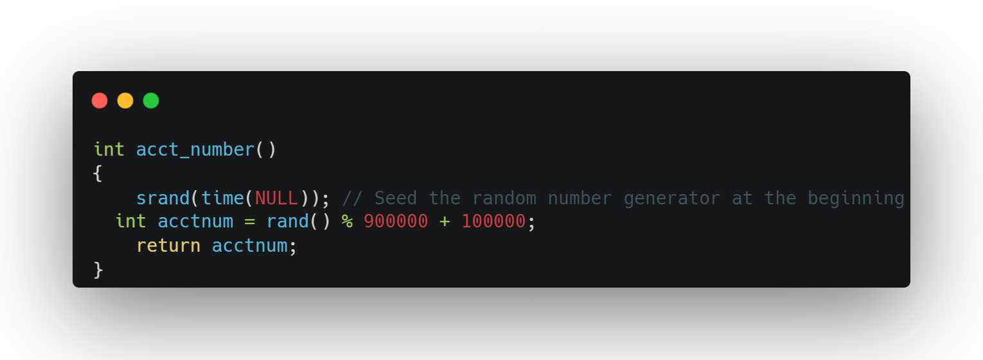
CODE :

Slide 6
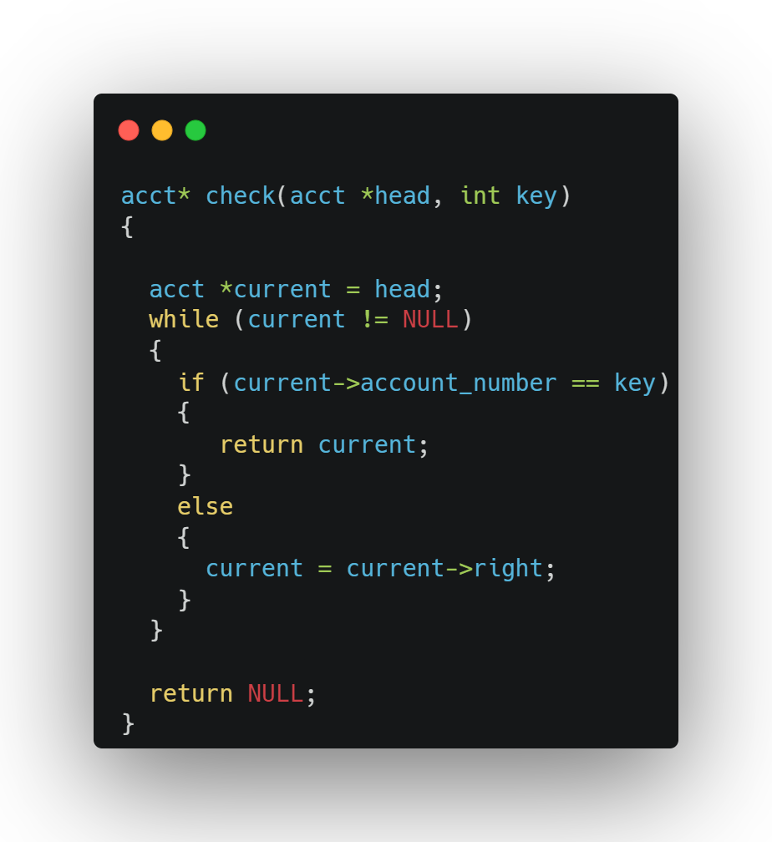

Slide 7
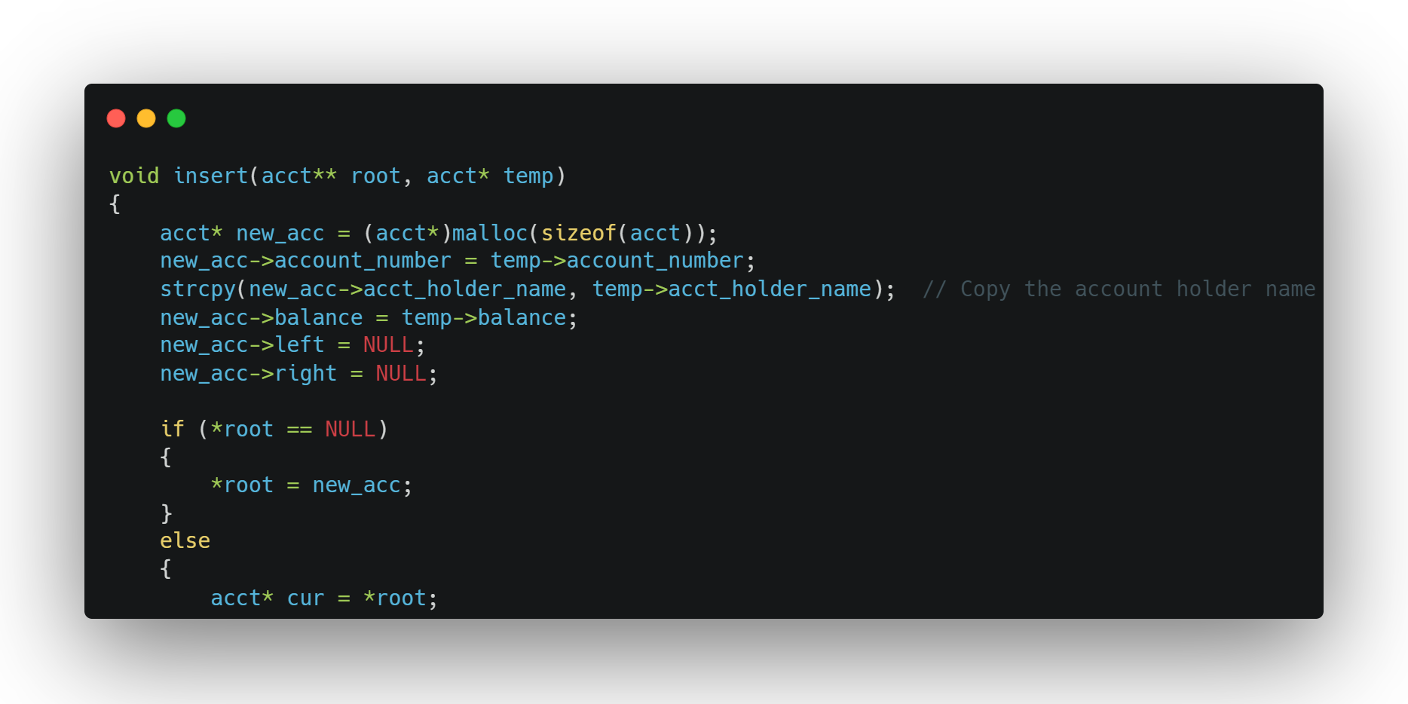

Slide 8
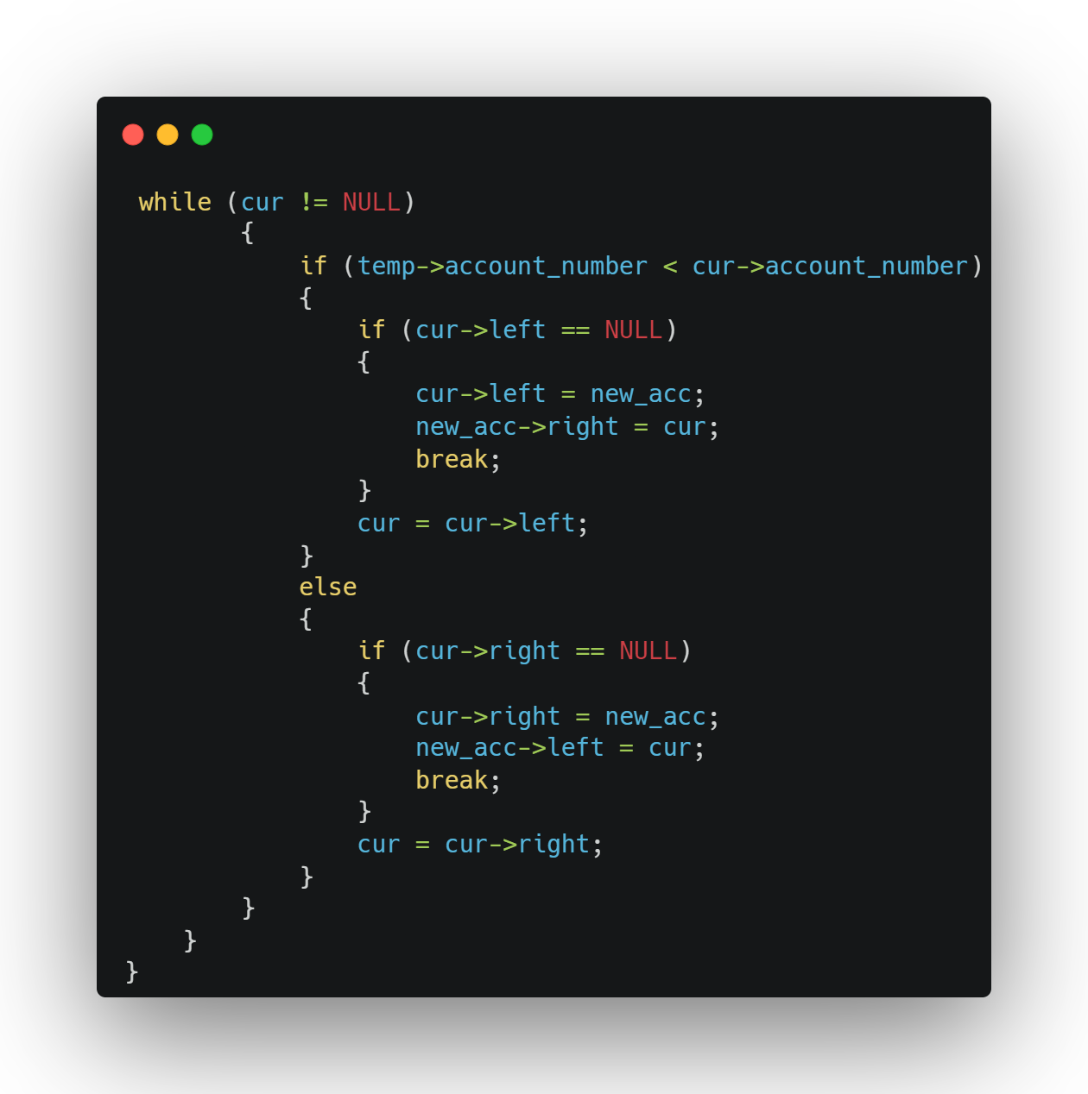

Slide 9
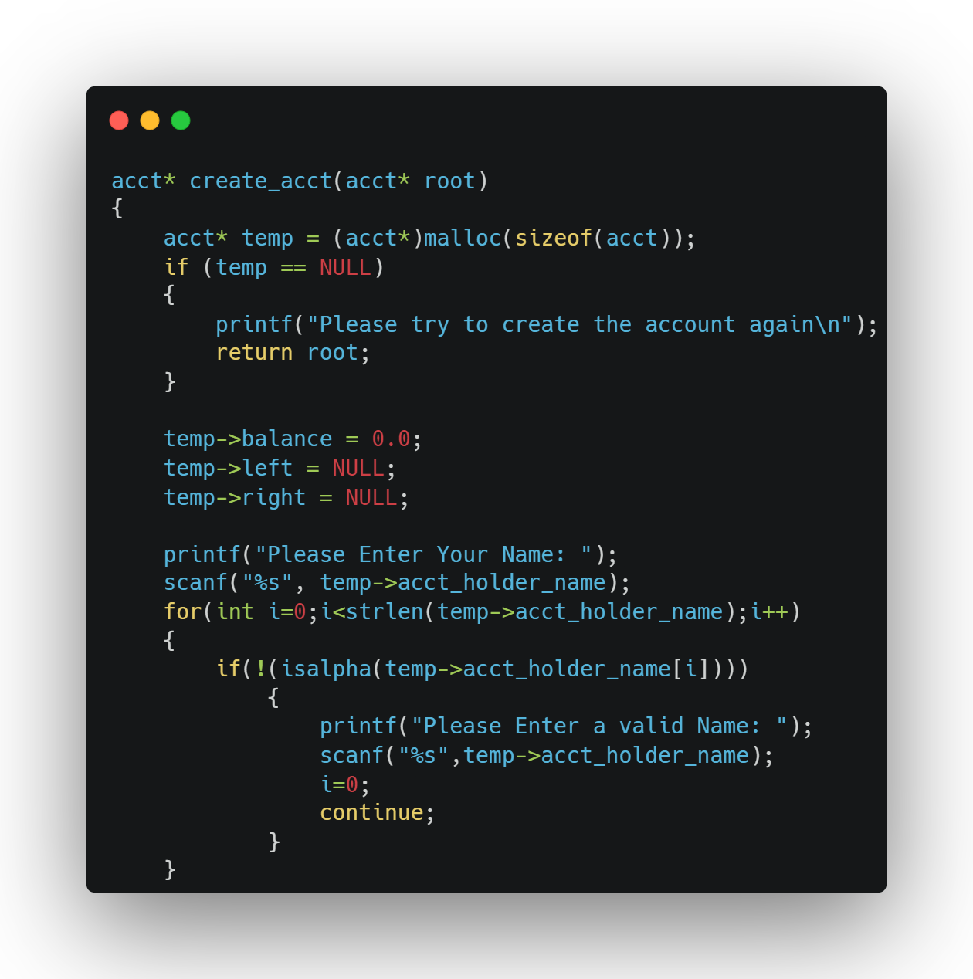

Slide 10
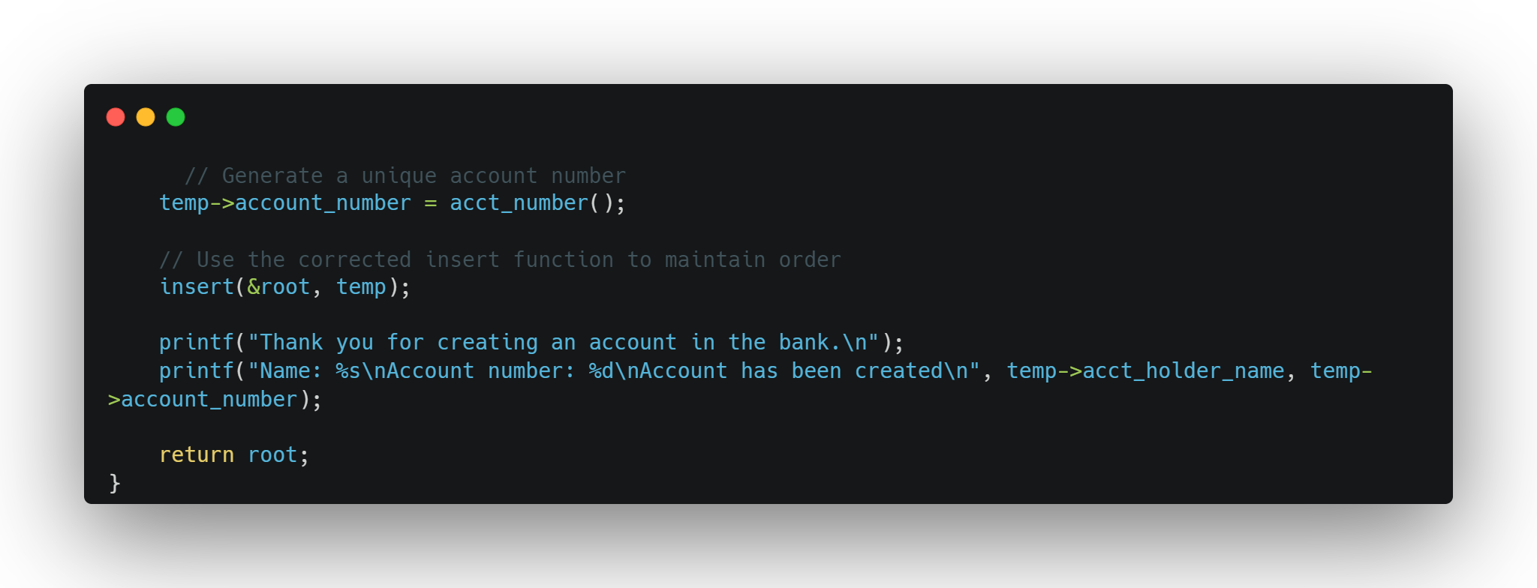

Slide 11
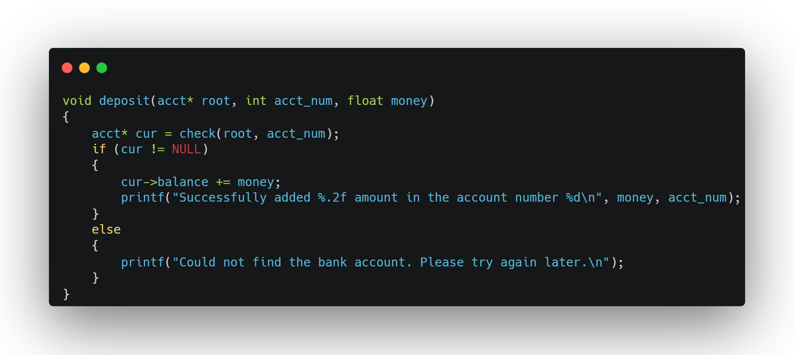

Slide 12
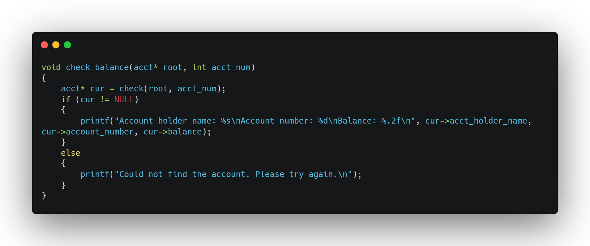

Slide 13
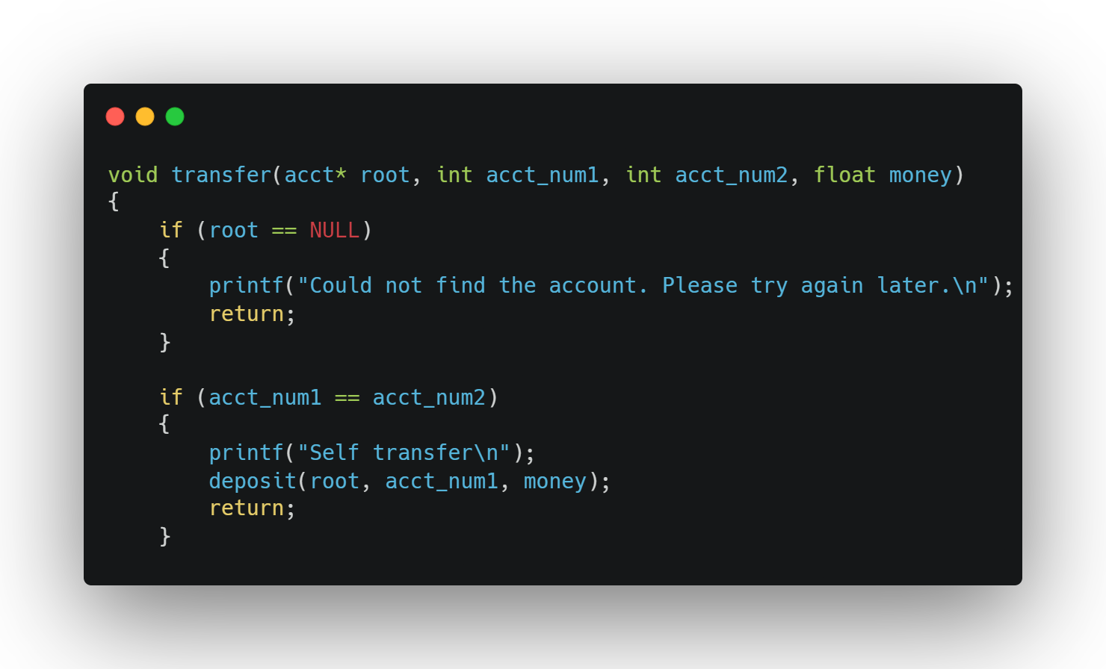

Slide 14
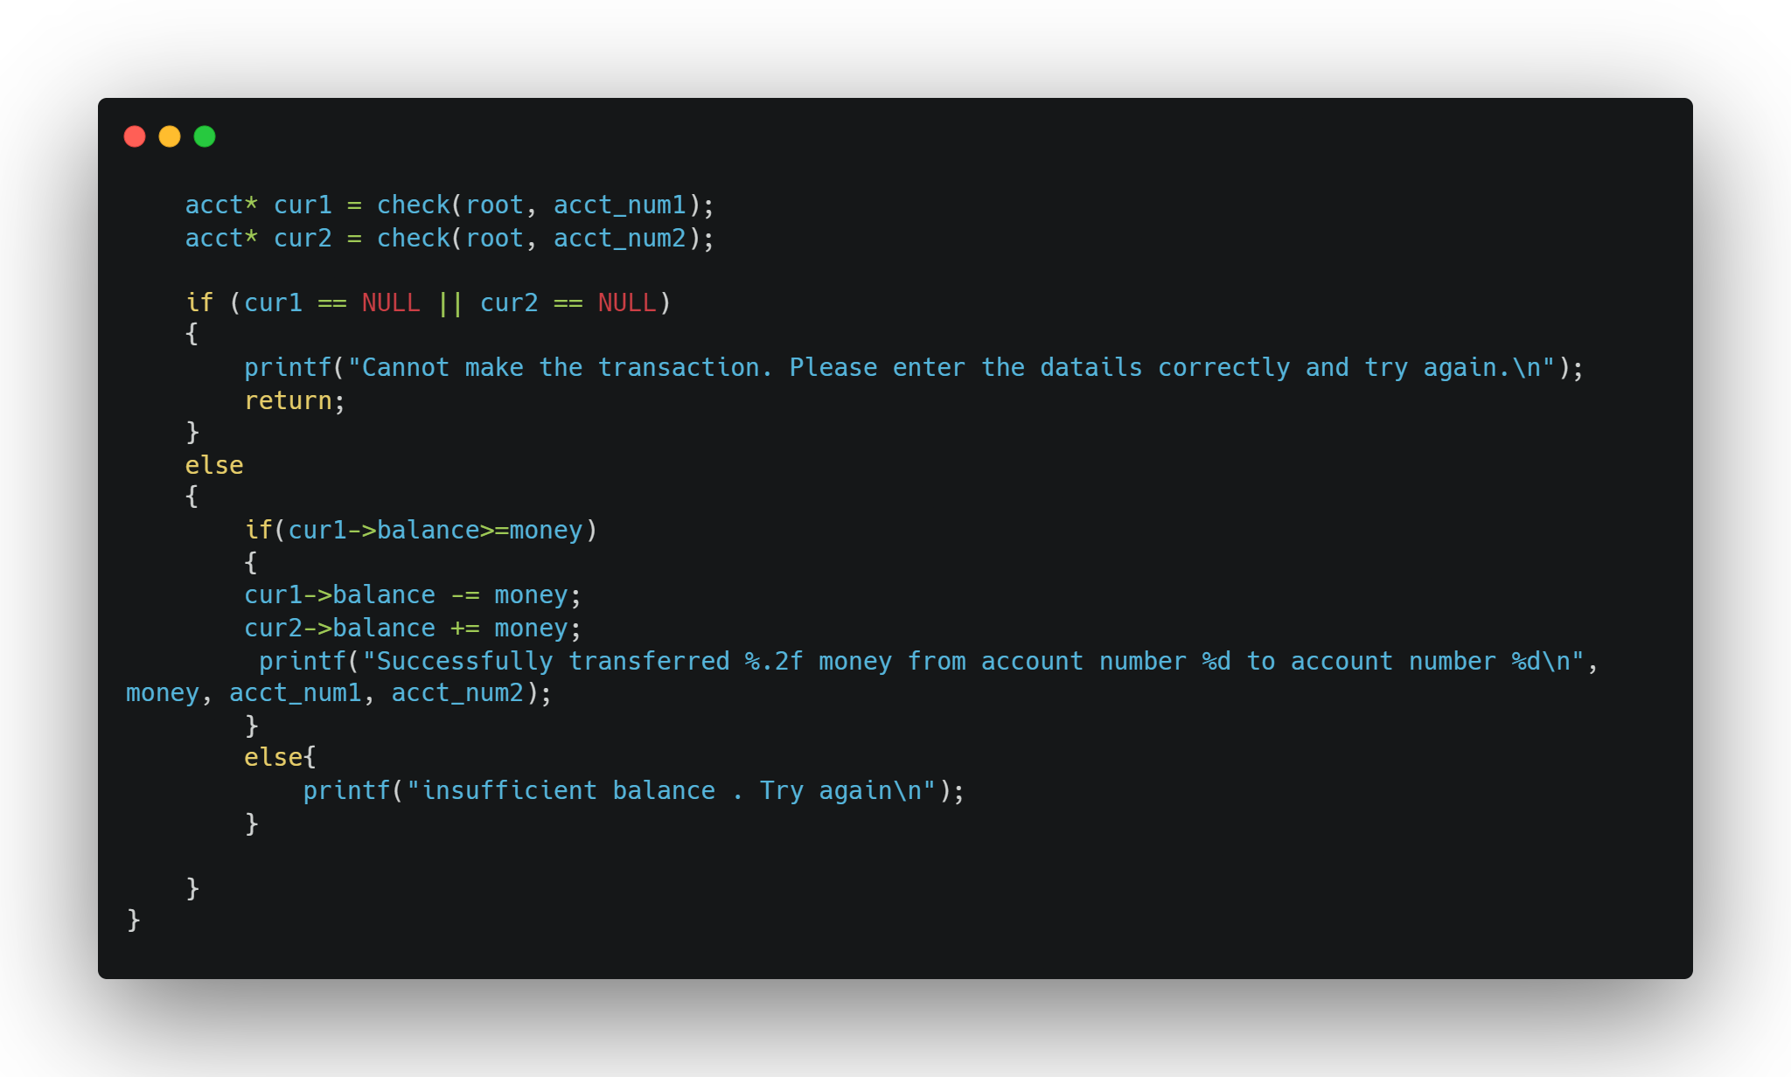

Slide 15
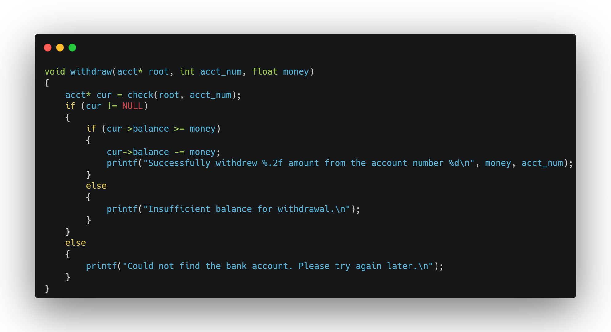

Slide 16
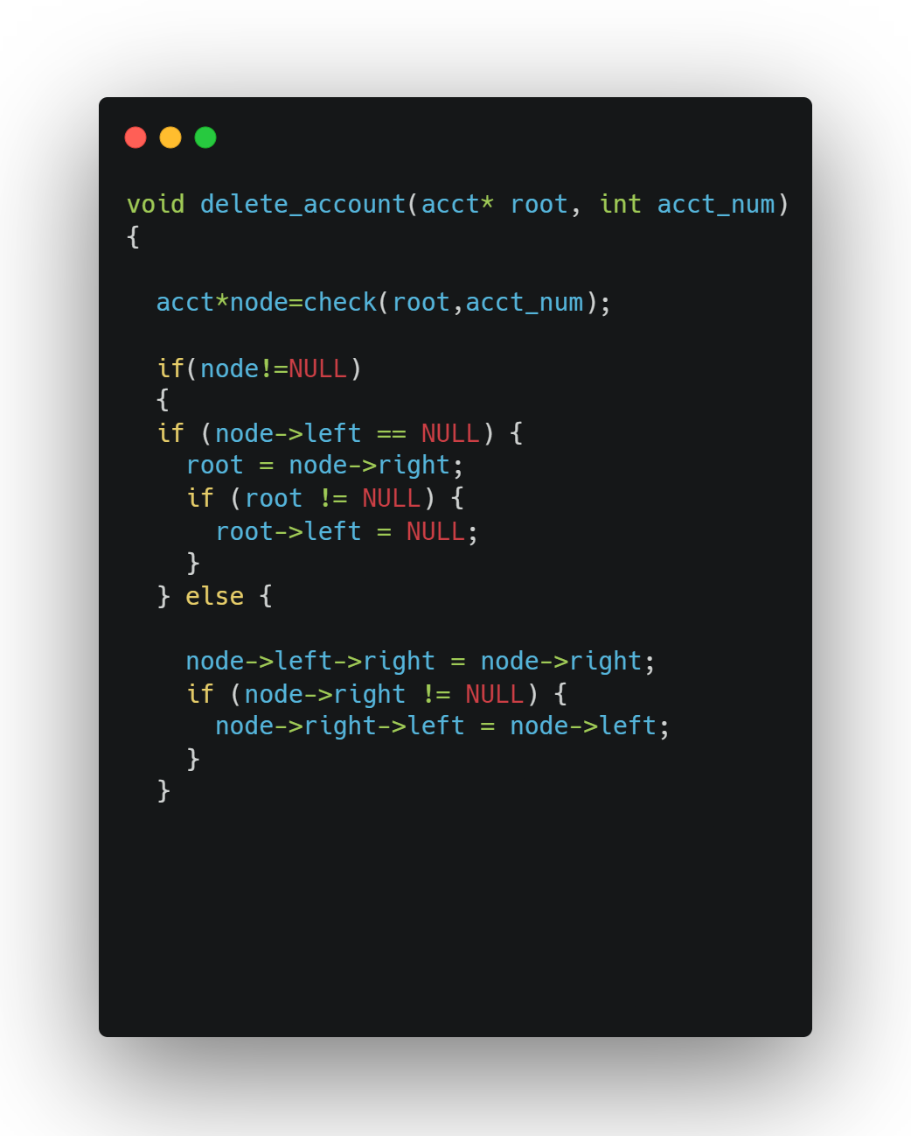

Slide 17
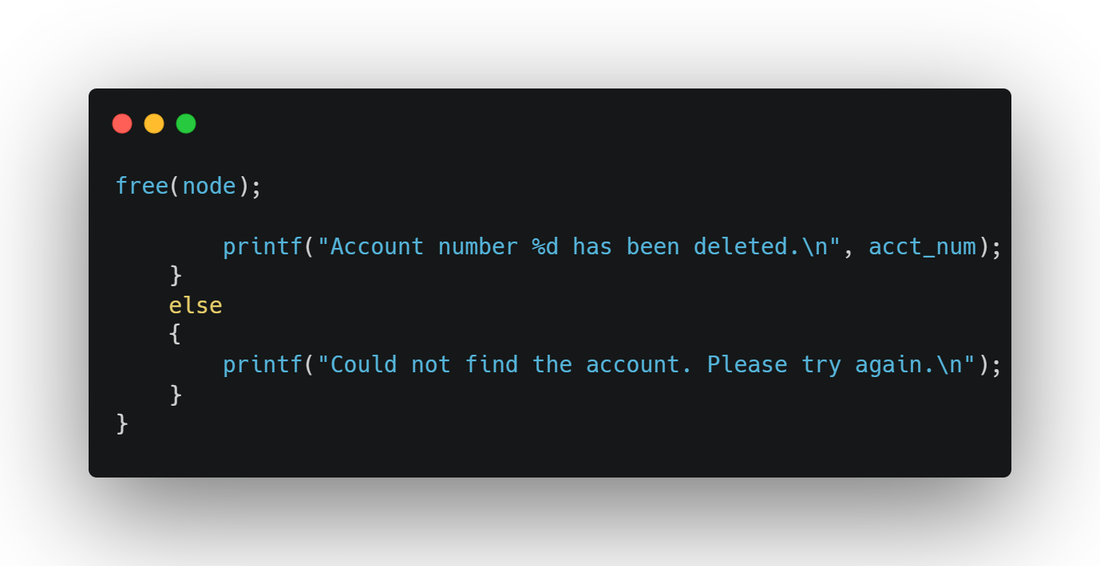

Slide 18
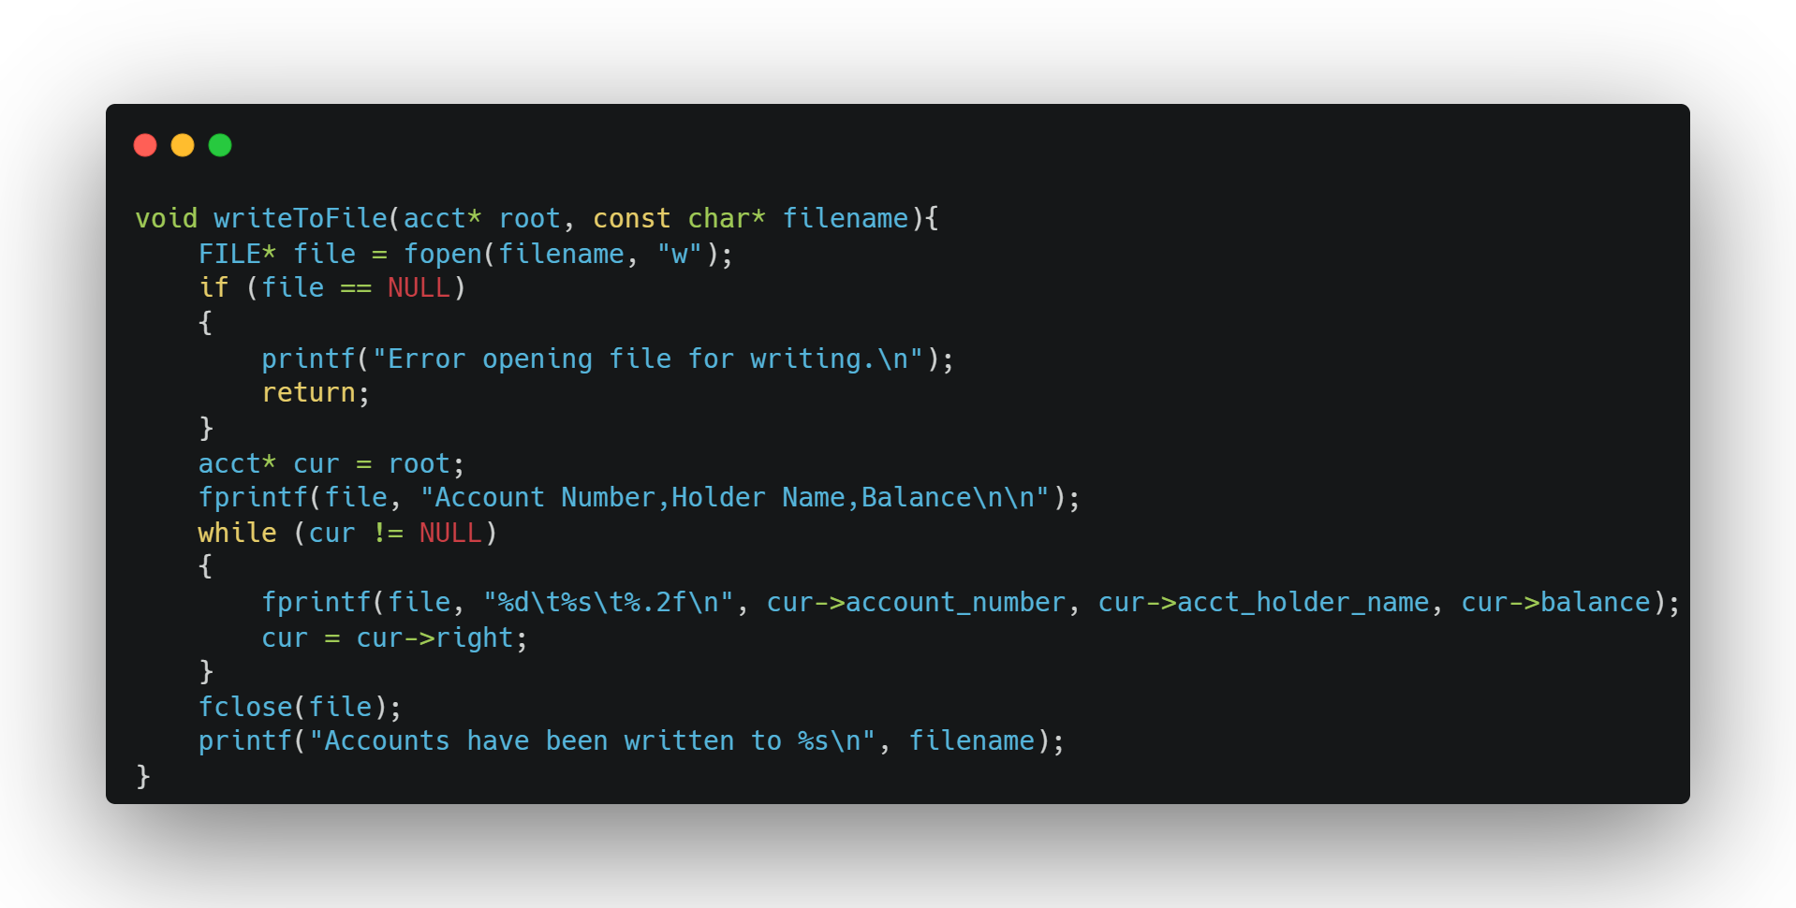

Slide 19
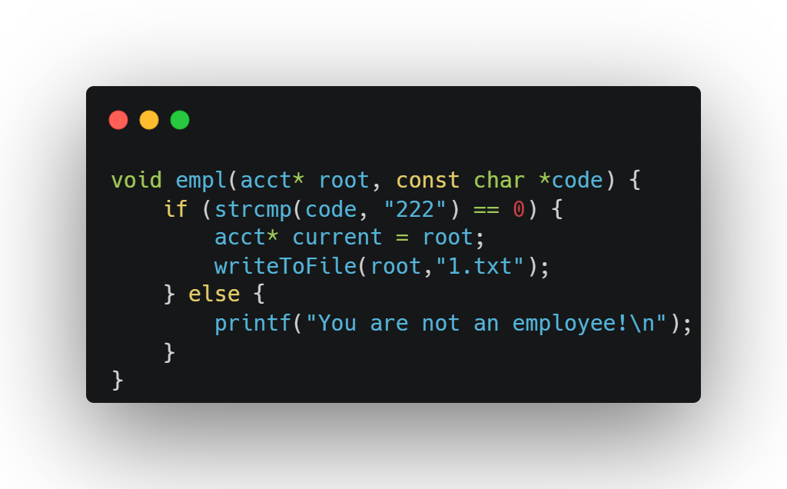

Slide 20

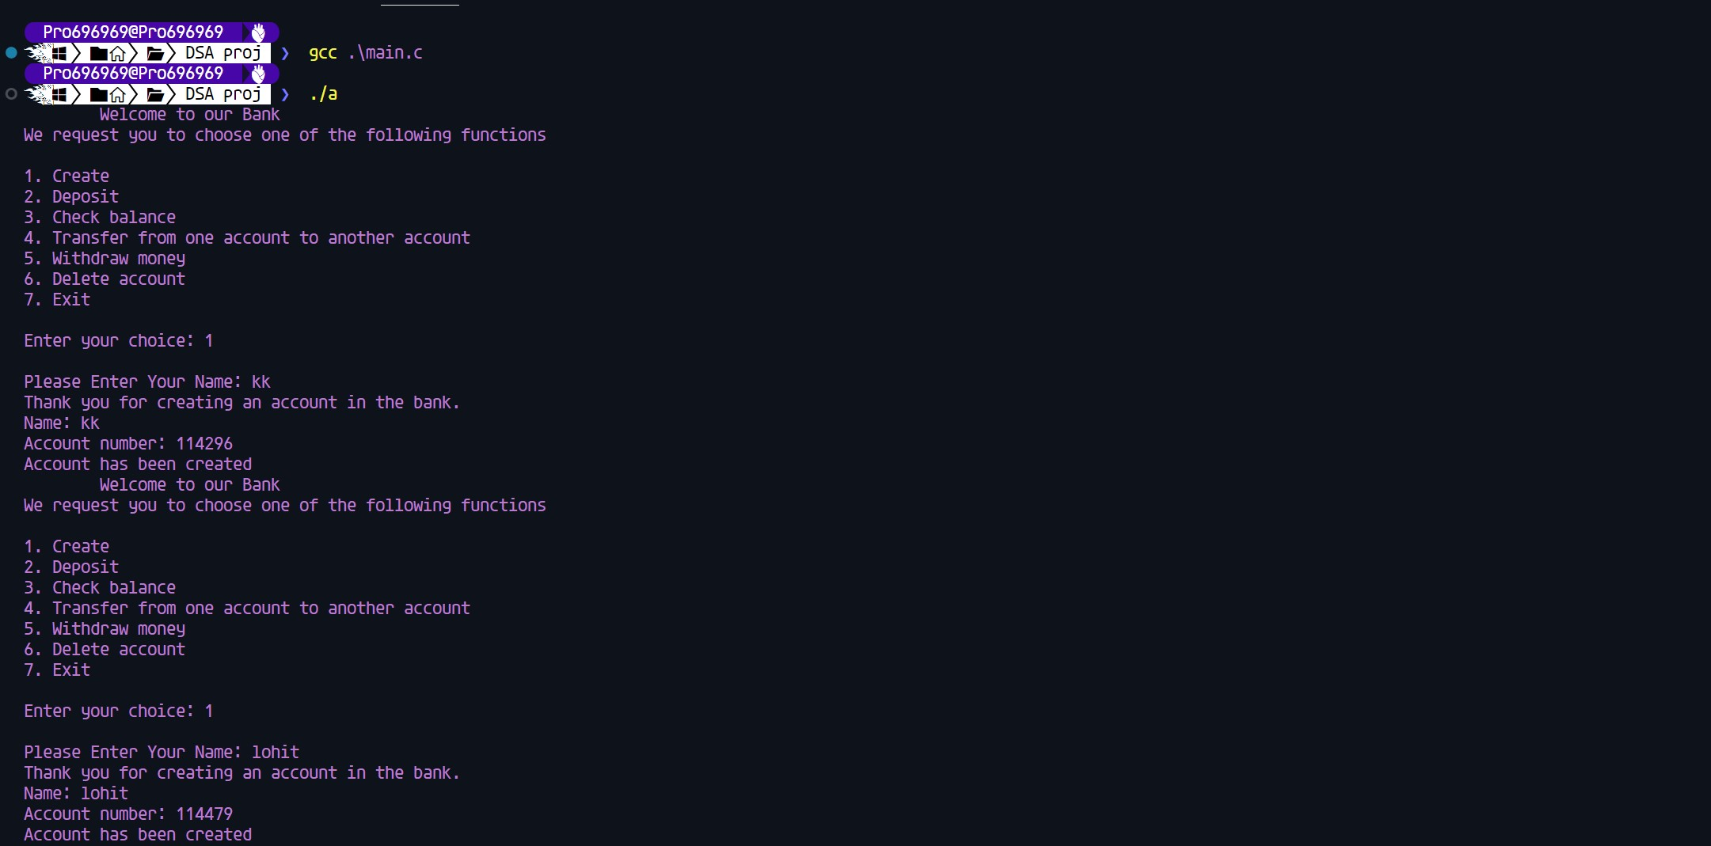
OUTPUTS :

Slide 21
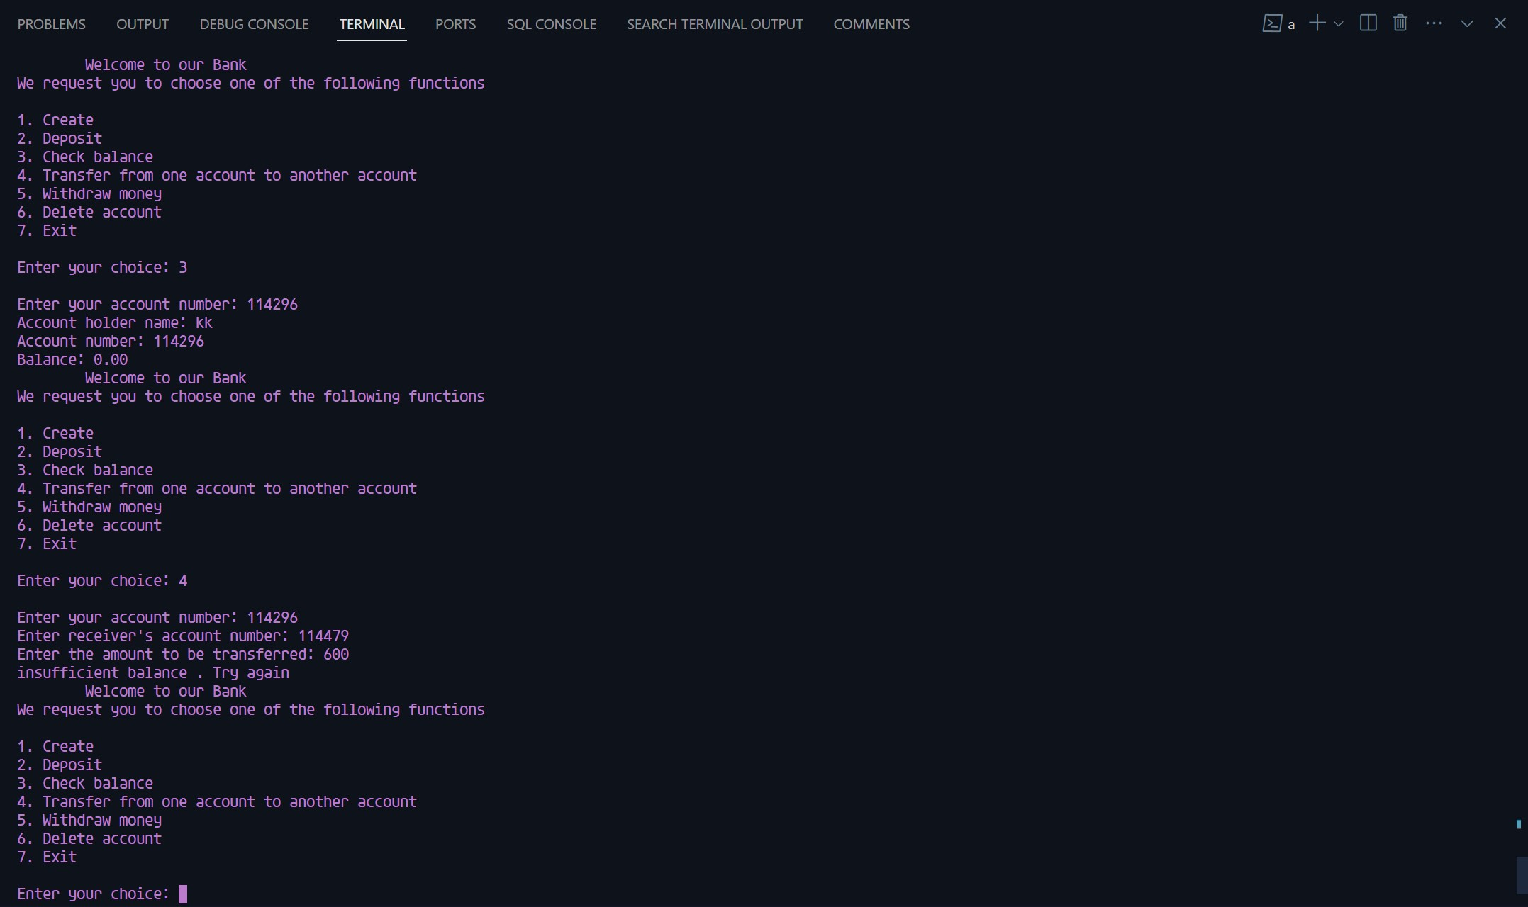

Slide 22
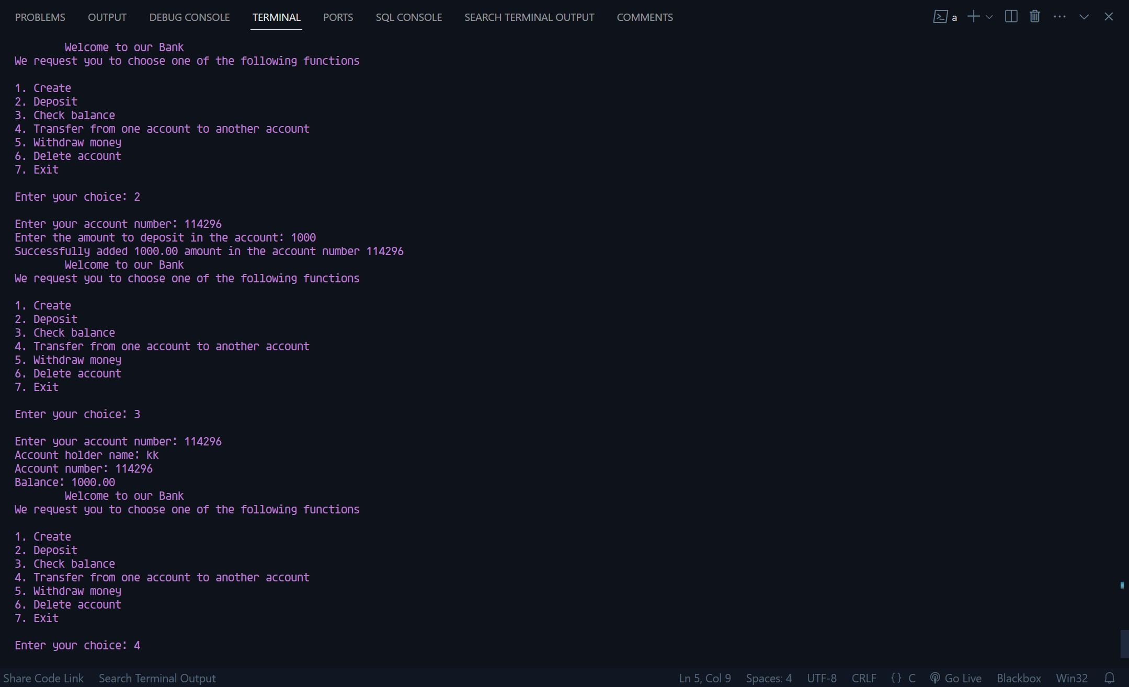

Slide 23
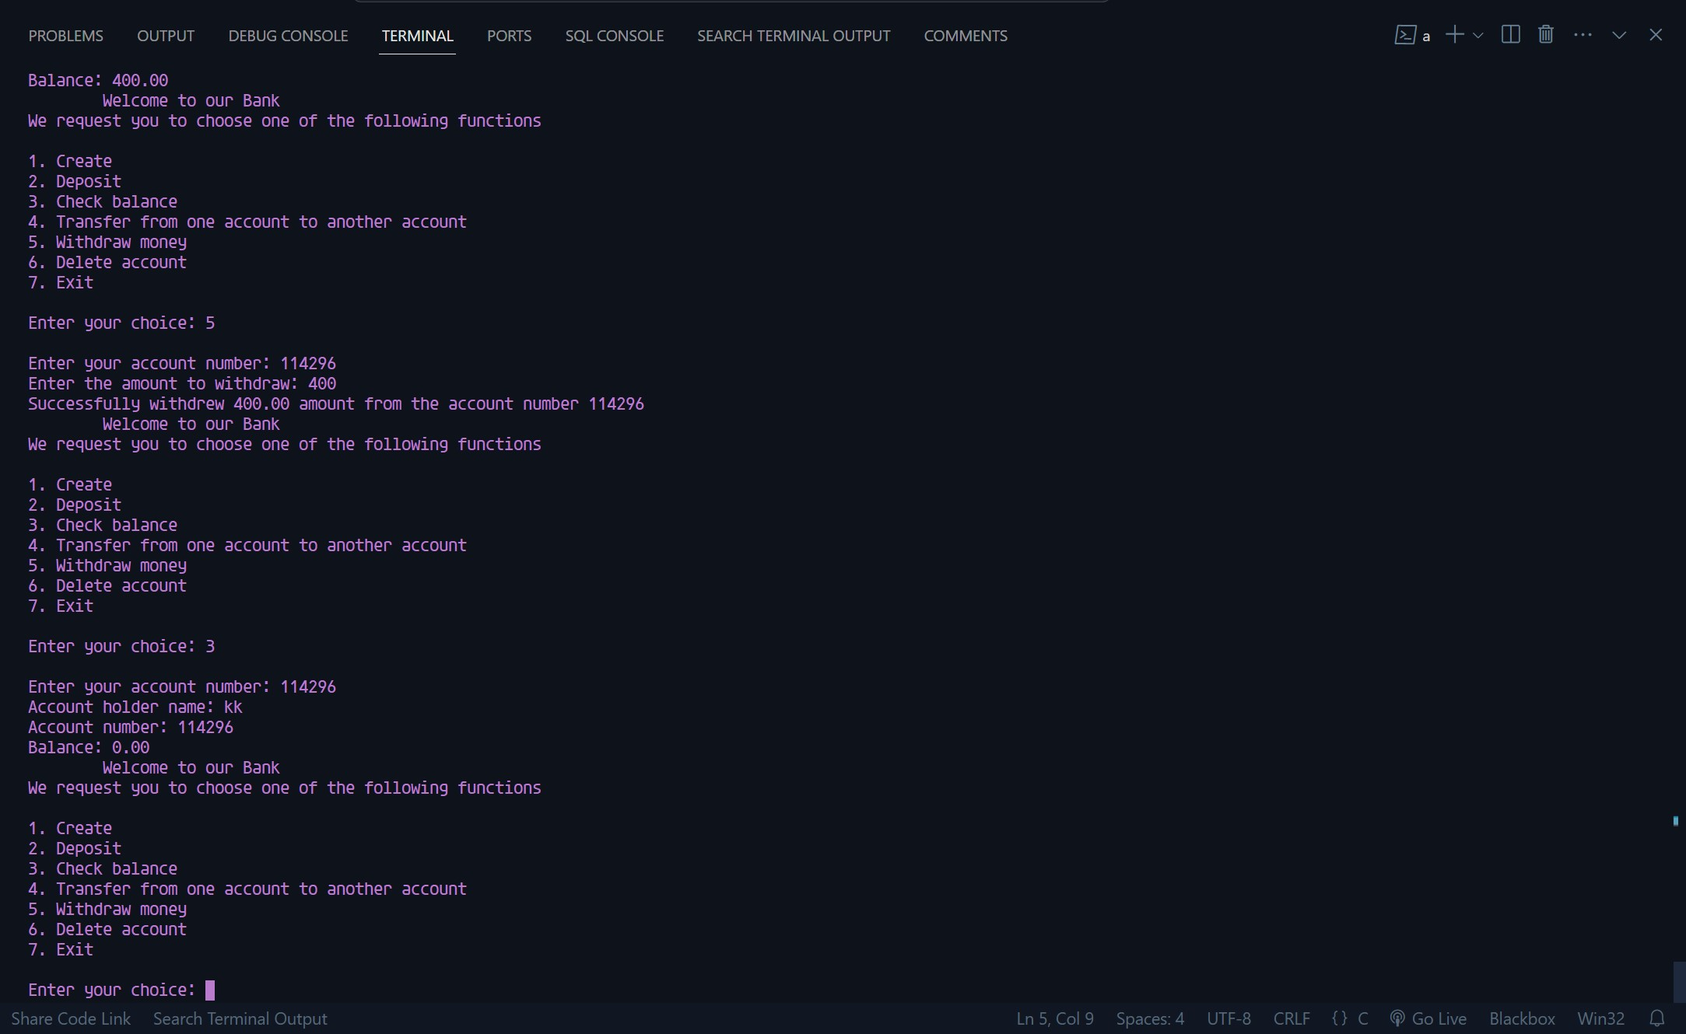

Slide 24
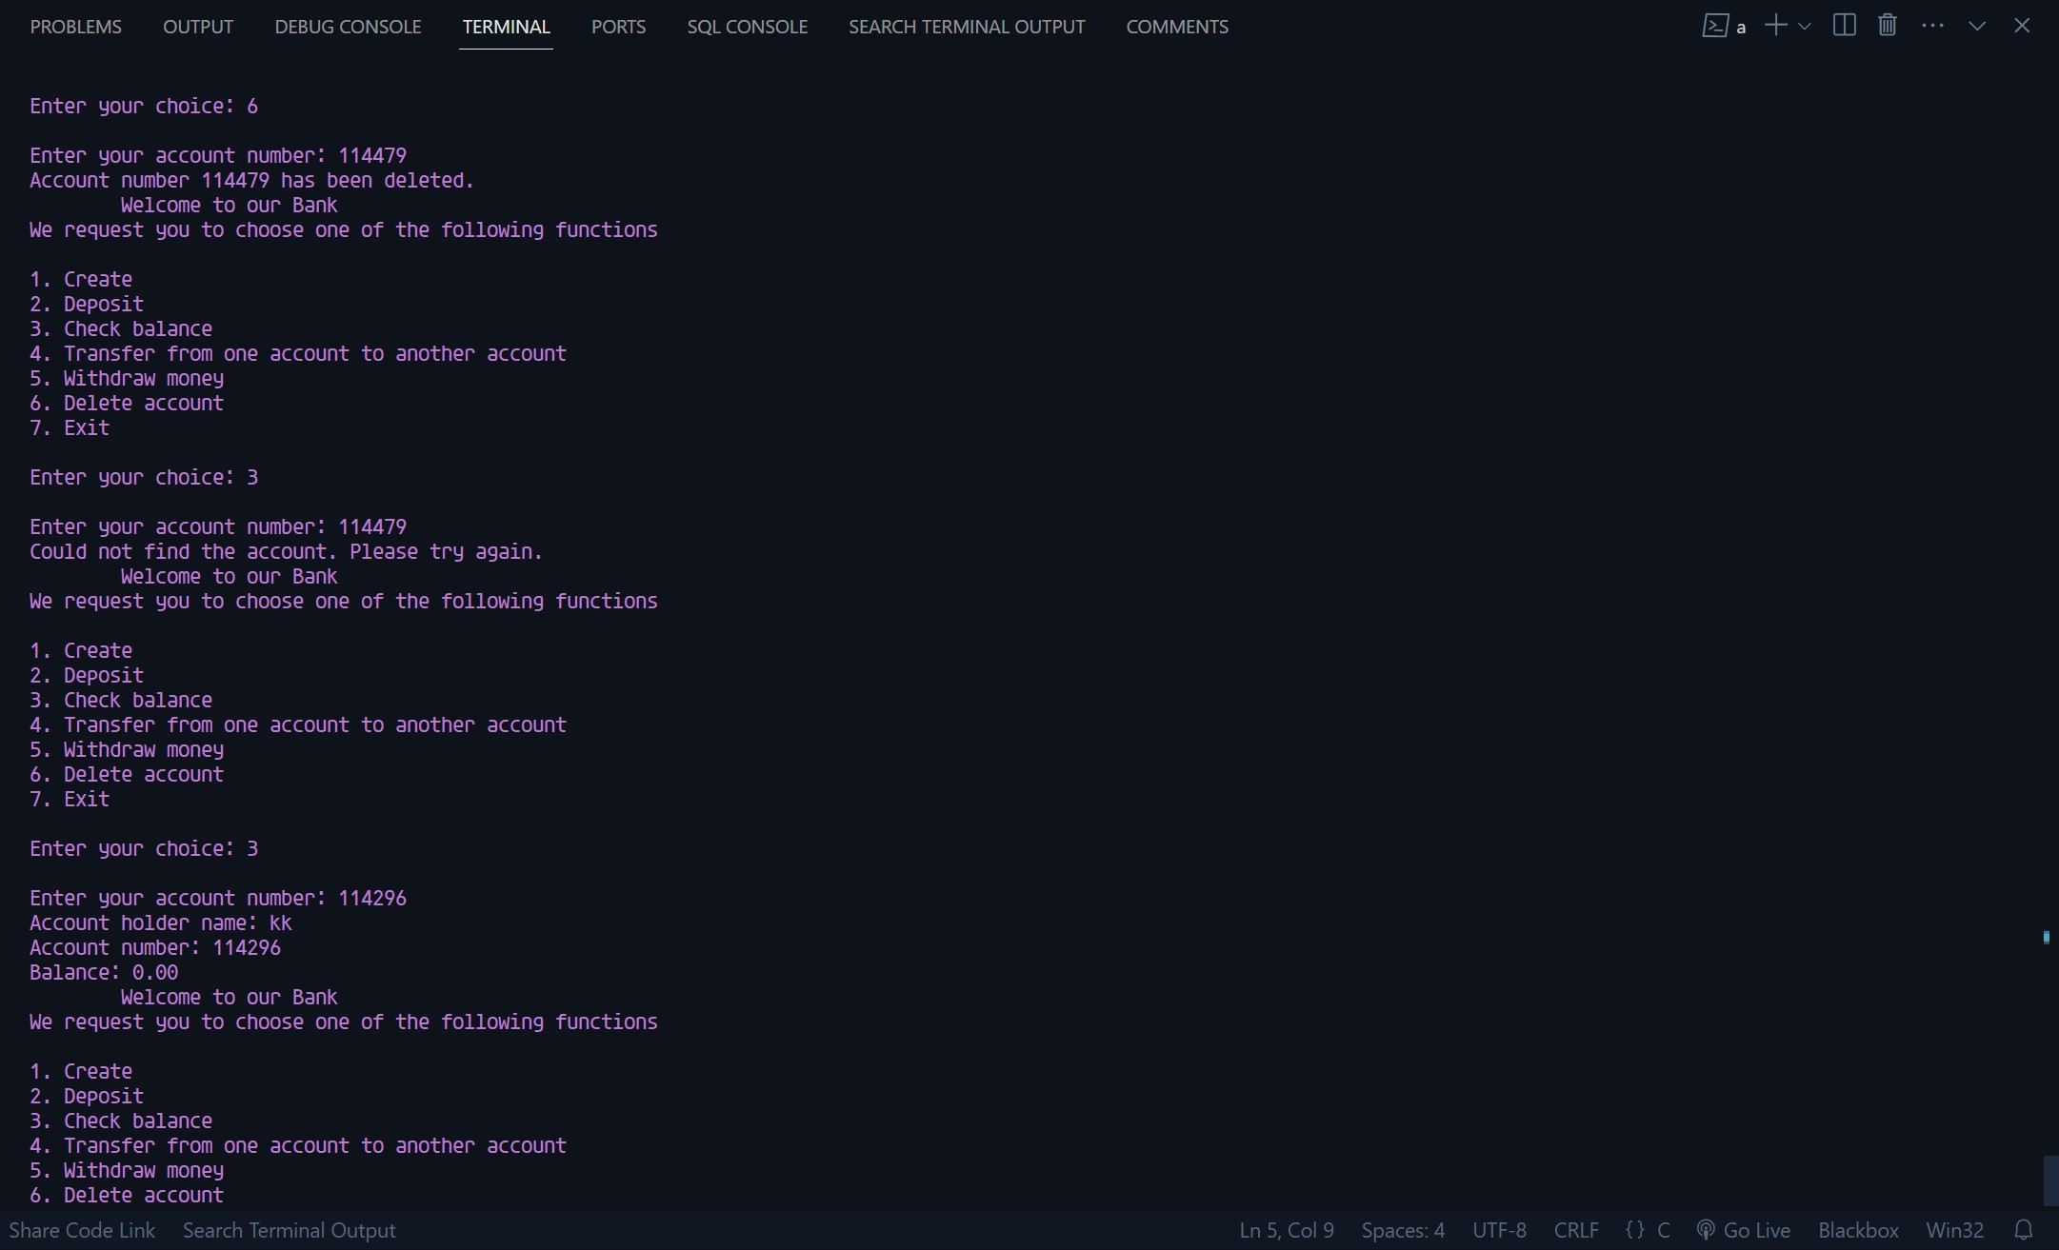

Slide 25
